Slide 1
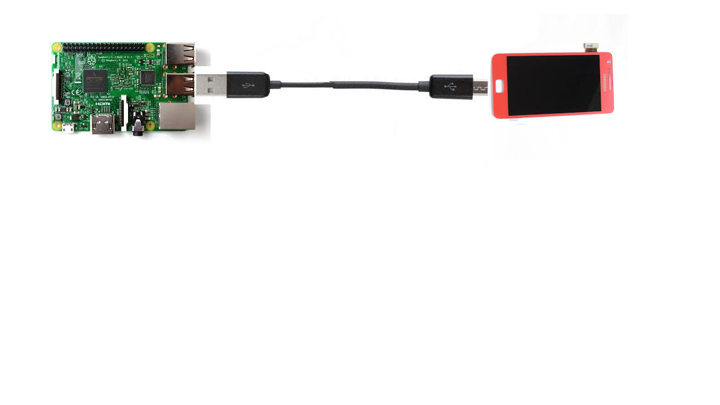
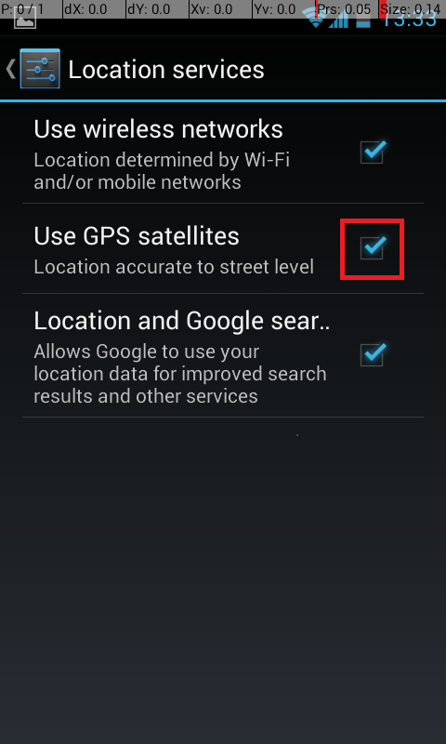
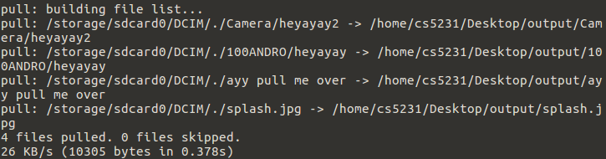
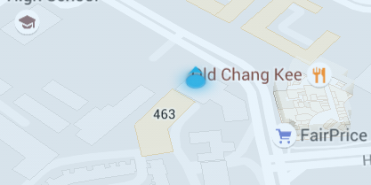
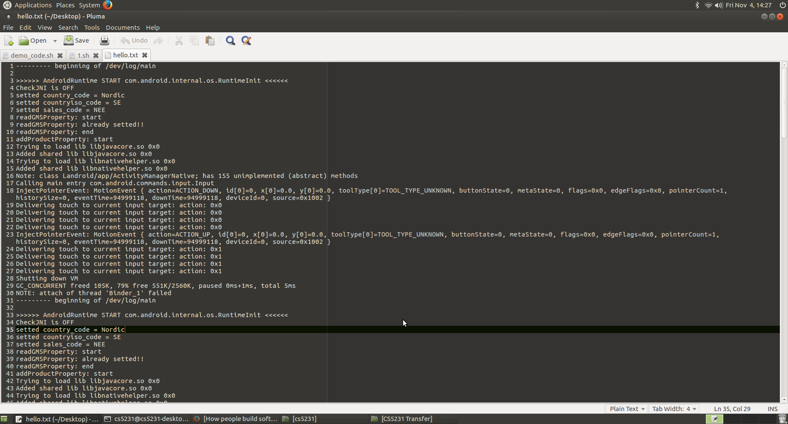
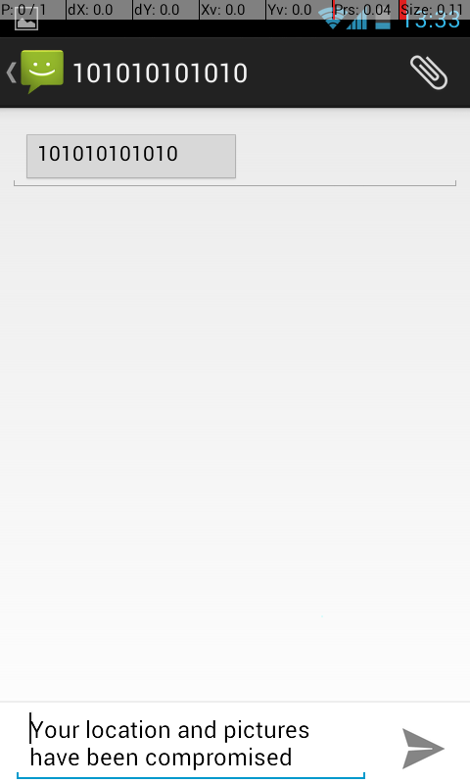
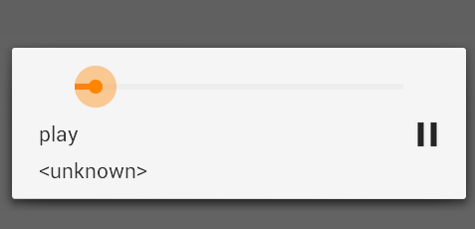
Android ADB Exploit by USB Connection to SBC
Introduction
A Single Board Computer can simulate a portable power bank due to the small form factor and potential to be enclosed within a custom casing. Tricking user to establish a connection with it.
Objective
Explore potential ways in which the specific process model of charging a smartphone, where a USB cable is used to establish physical connection to a power bank, can be exploited to gain unauthorized access to said smartphone.
Changing settings
Copying of Data
Obtain Location
Logging
Showing SMS
Play Music

